Slide 1
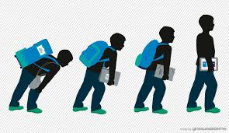
ADAPT
Assisting Digital Age Parents with Technology TOT
Digital Learning Services
San Bernardino County Superintendent of Schools

Slide 2
Welcome
Ymasumac Marañón Davis
Sue Christensen

Slide 3
Agenda
Welcome, purpose, overview
Foundation Strand
Break
Transition Strand
Lunch
Innovative Strand
Build Innovative Modules
Planning for ADAPT

Slide 4
Who’s in the room?
http://padlet.com/ymasumac9/welcome

Slide 5
What do you see?

Slide 6
Chocolate Milk & a Runner
Notes:
Tell story of Misak and Me in the grocery store and chocolate

Slide 7
Notes:
The challenge: Changing the perception of what others see vs what I see or know to be true

Slide 8
Find this image here http://204.100.66.21:15871/cgi-bin/blockpage.cgi?ws-session=1899284529

Slide 9
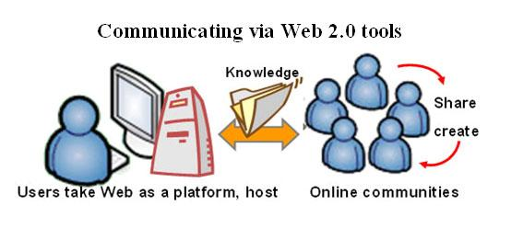
Web 2.0 Tools
Find this image here http://upload.wikimedia.org/wikibooks/en/9/92/Web2.0_tool.jpg

Slide 10
Tools for fun: Bitstrips

Slide 11
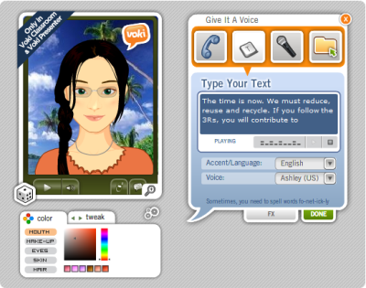
Tools for learning

Slide 12
21st Century Tools in the classroom

Slide 13
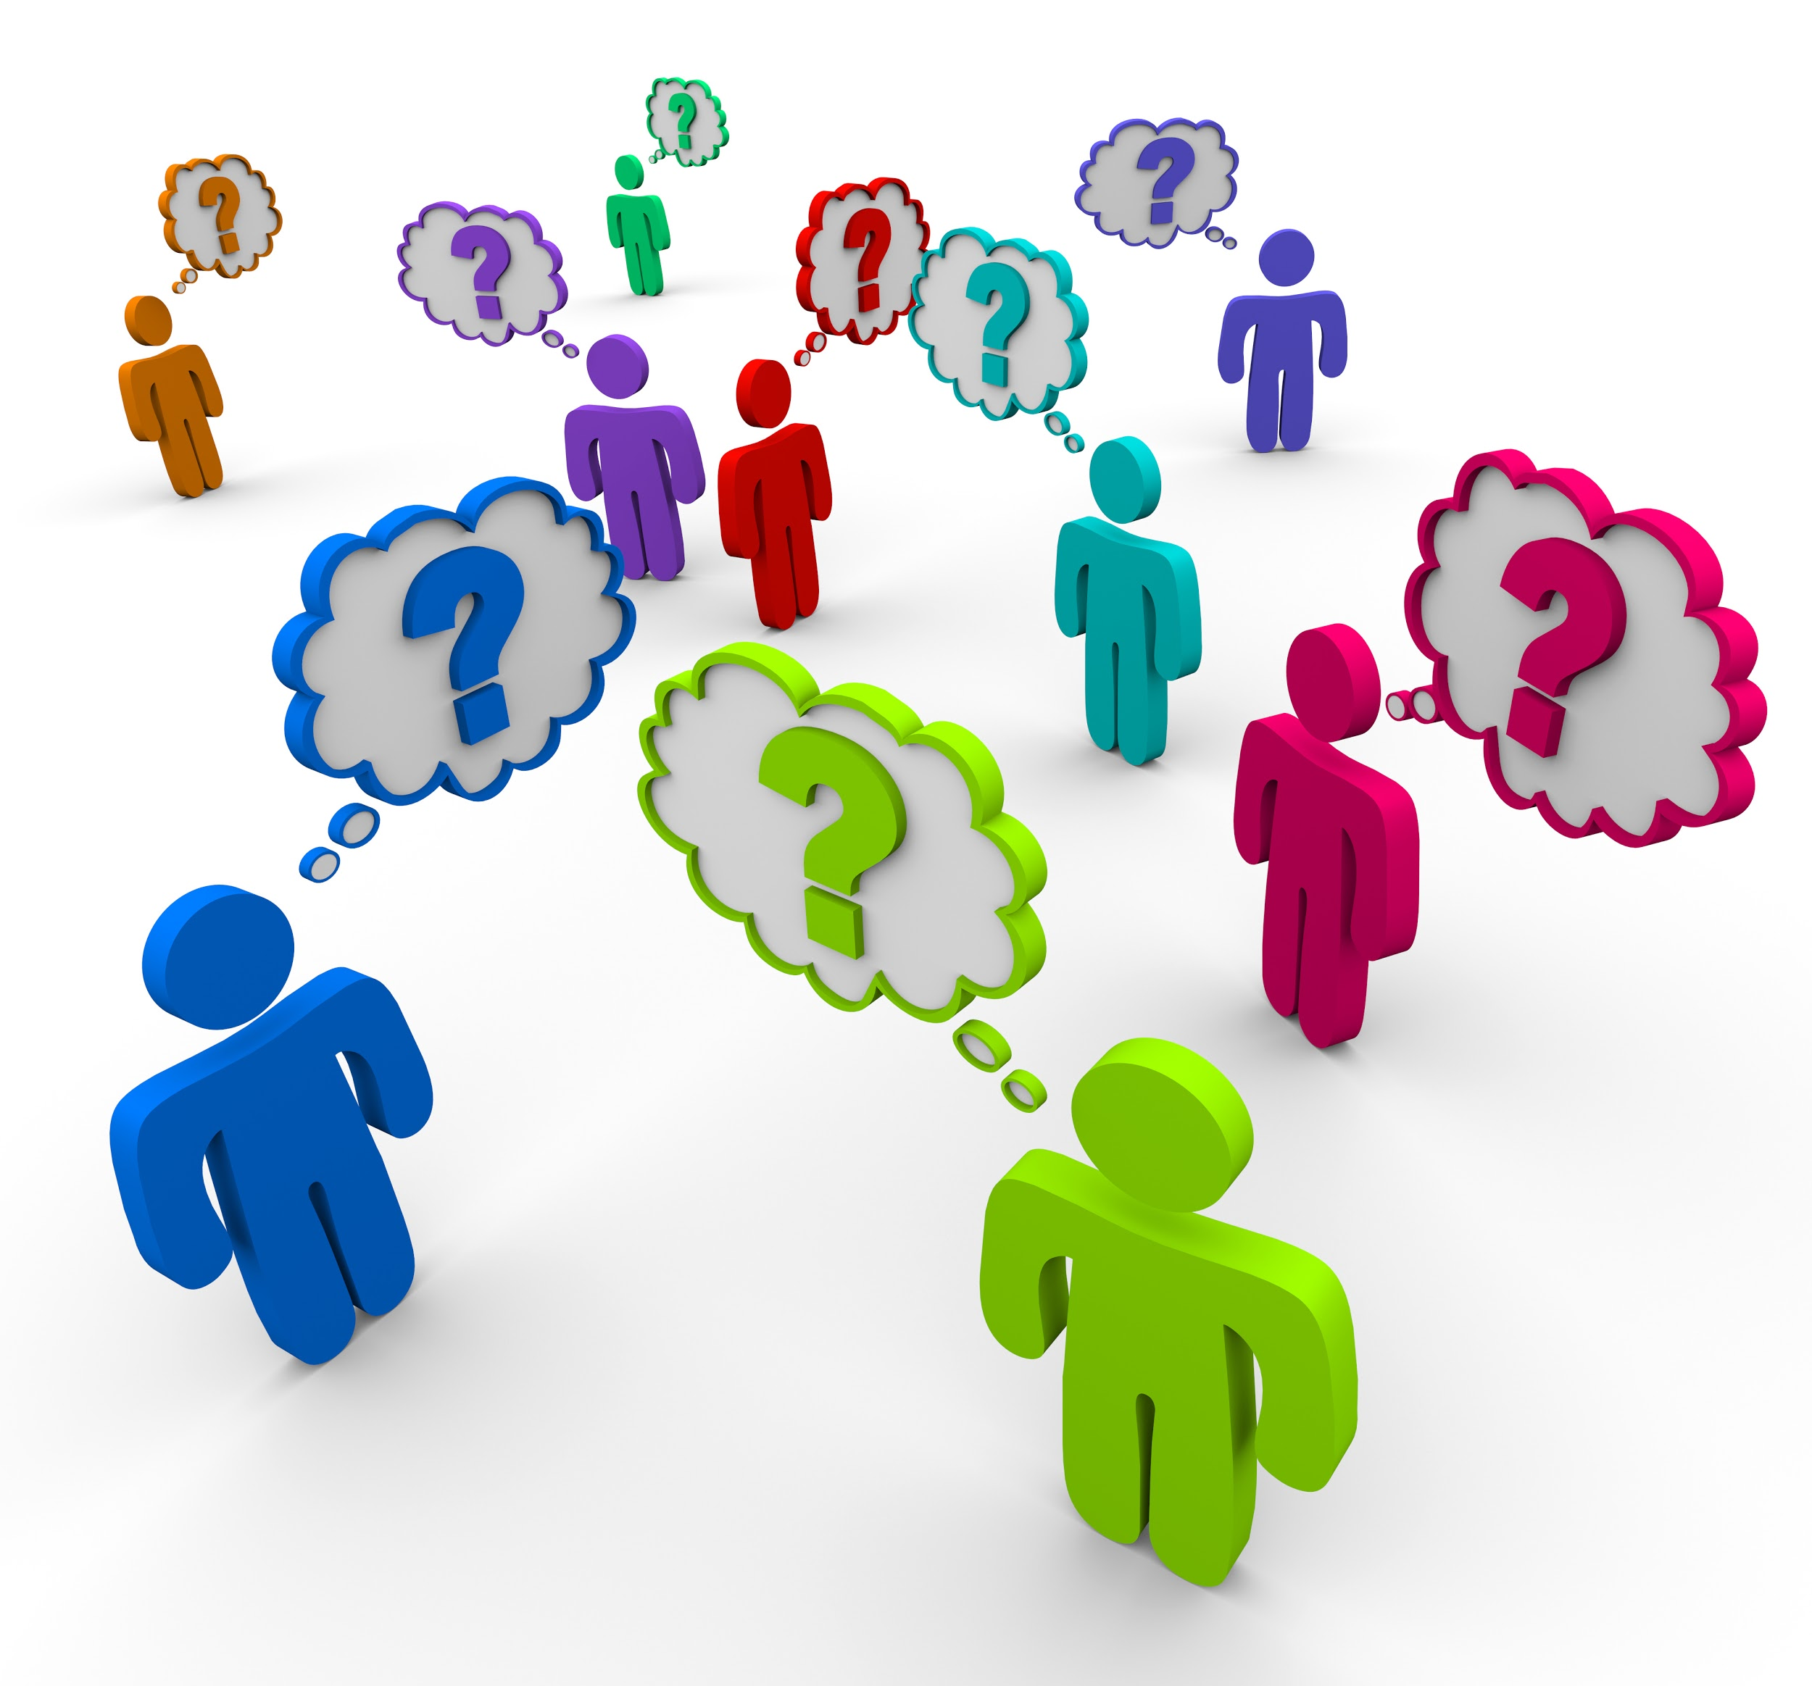
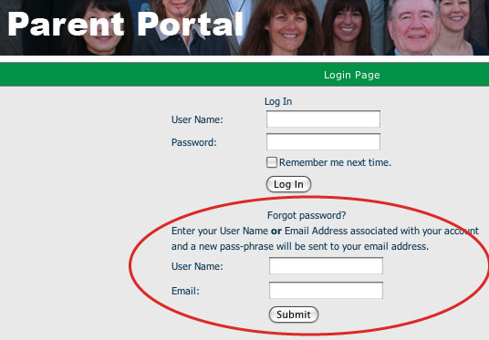
How do we engage families in a meaningful way?

Slide 14
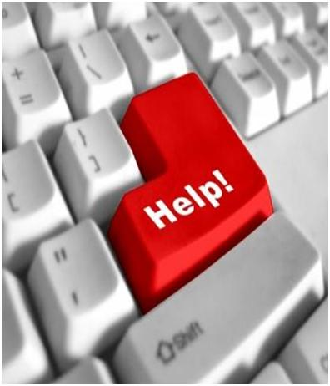

Slide 15
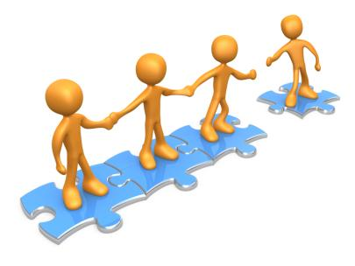
Building Capacity

Slide 16
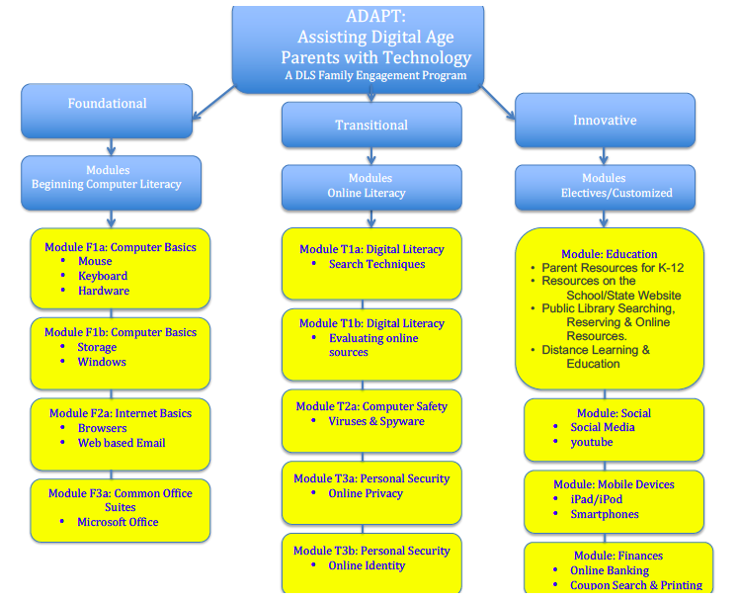

Slide 17
Implementing ADAPT
Monday
Foundation
Wednesday
Transition
Tuesday
Foundation
Thursday
Transition
Monthly
Innovation Workshops
ADAPT Trainers
Monthly
Innovation Workshops

Slide 18
Foundation Strand
tinyurl.com/dlsadapt
Login sbcssadapt
Pin 3819
Notes:
Go to Website

Slide 19
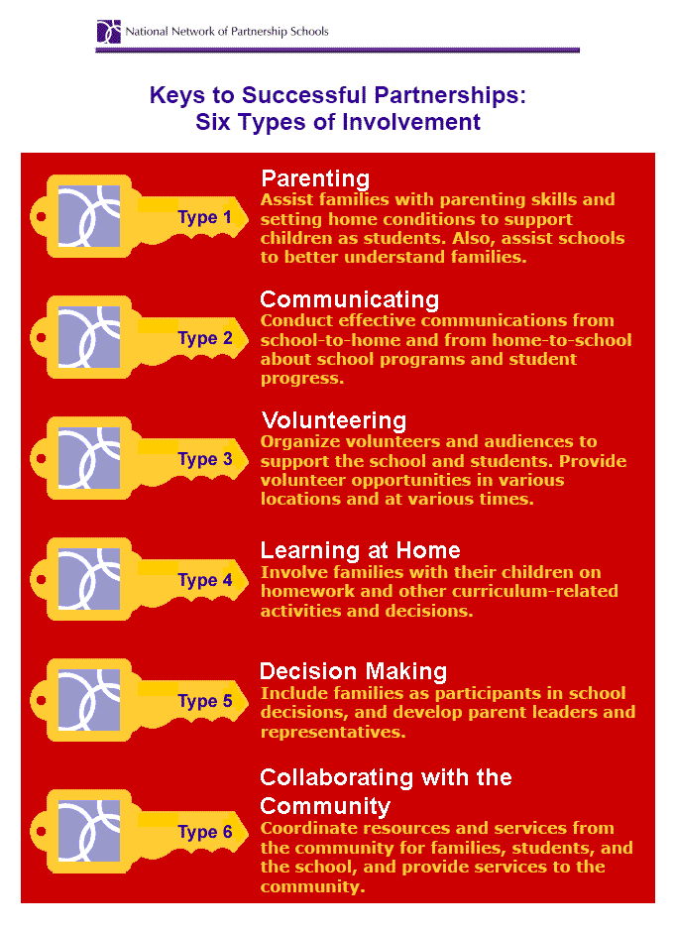

Slide 20
Planning for ADAPT

Slide 21
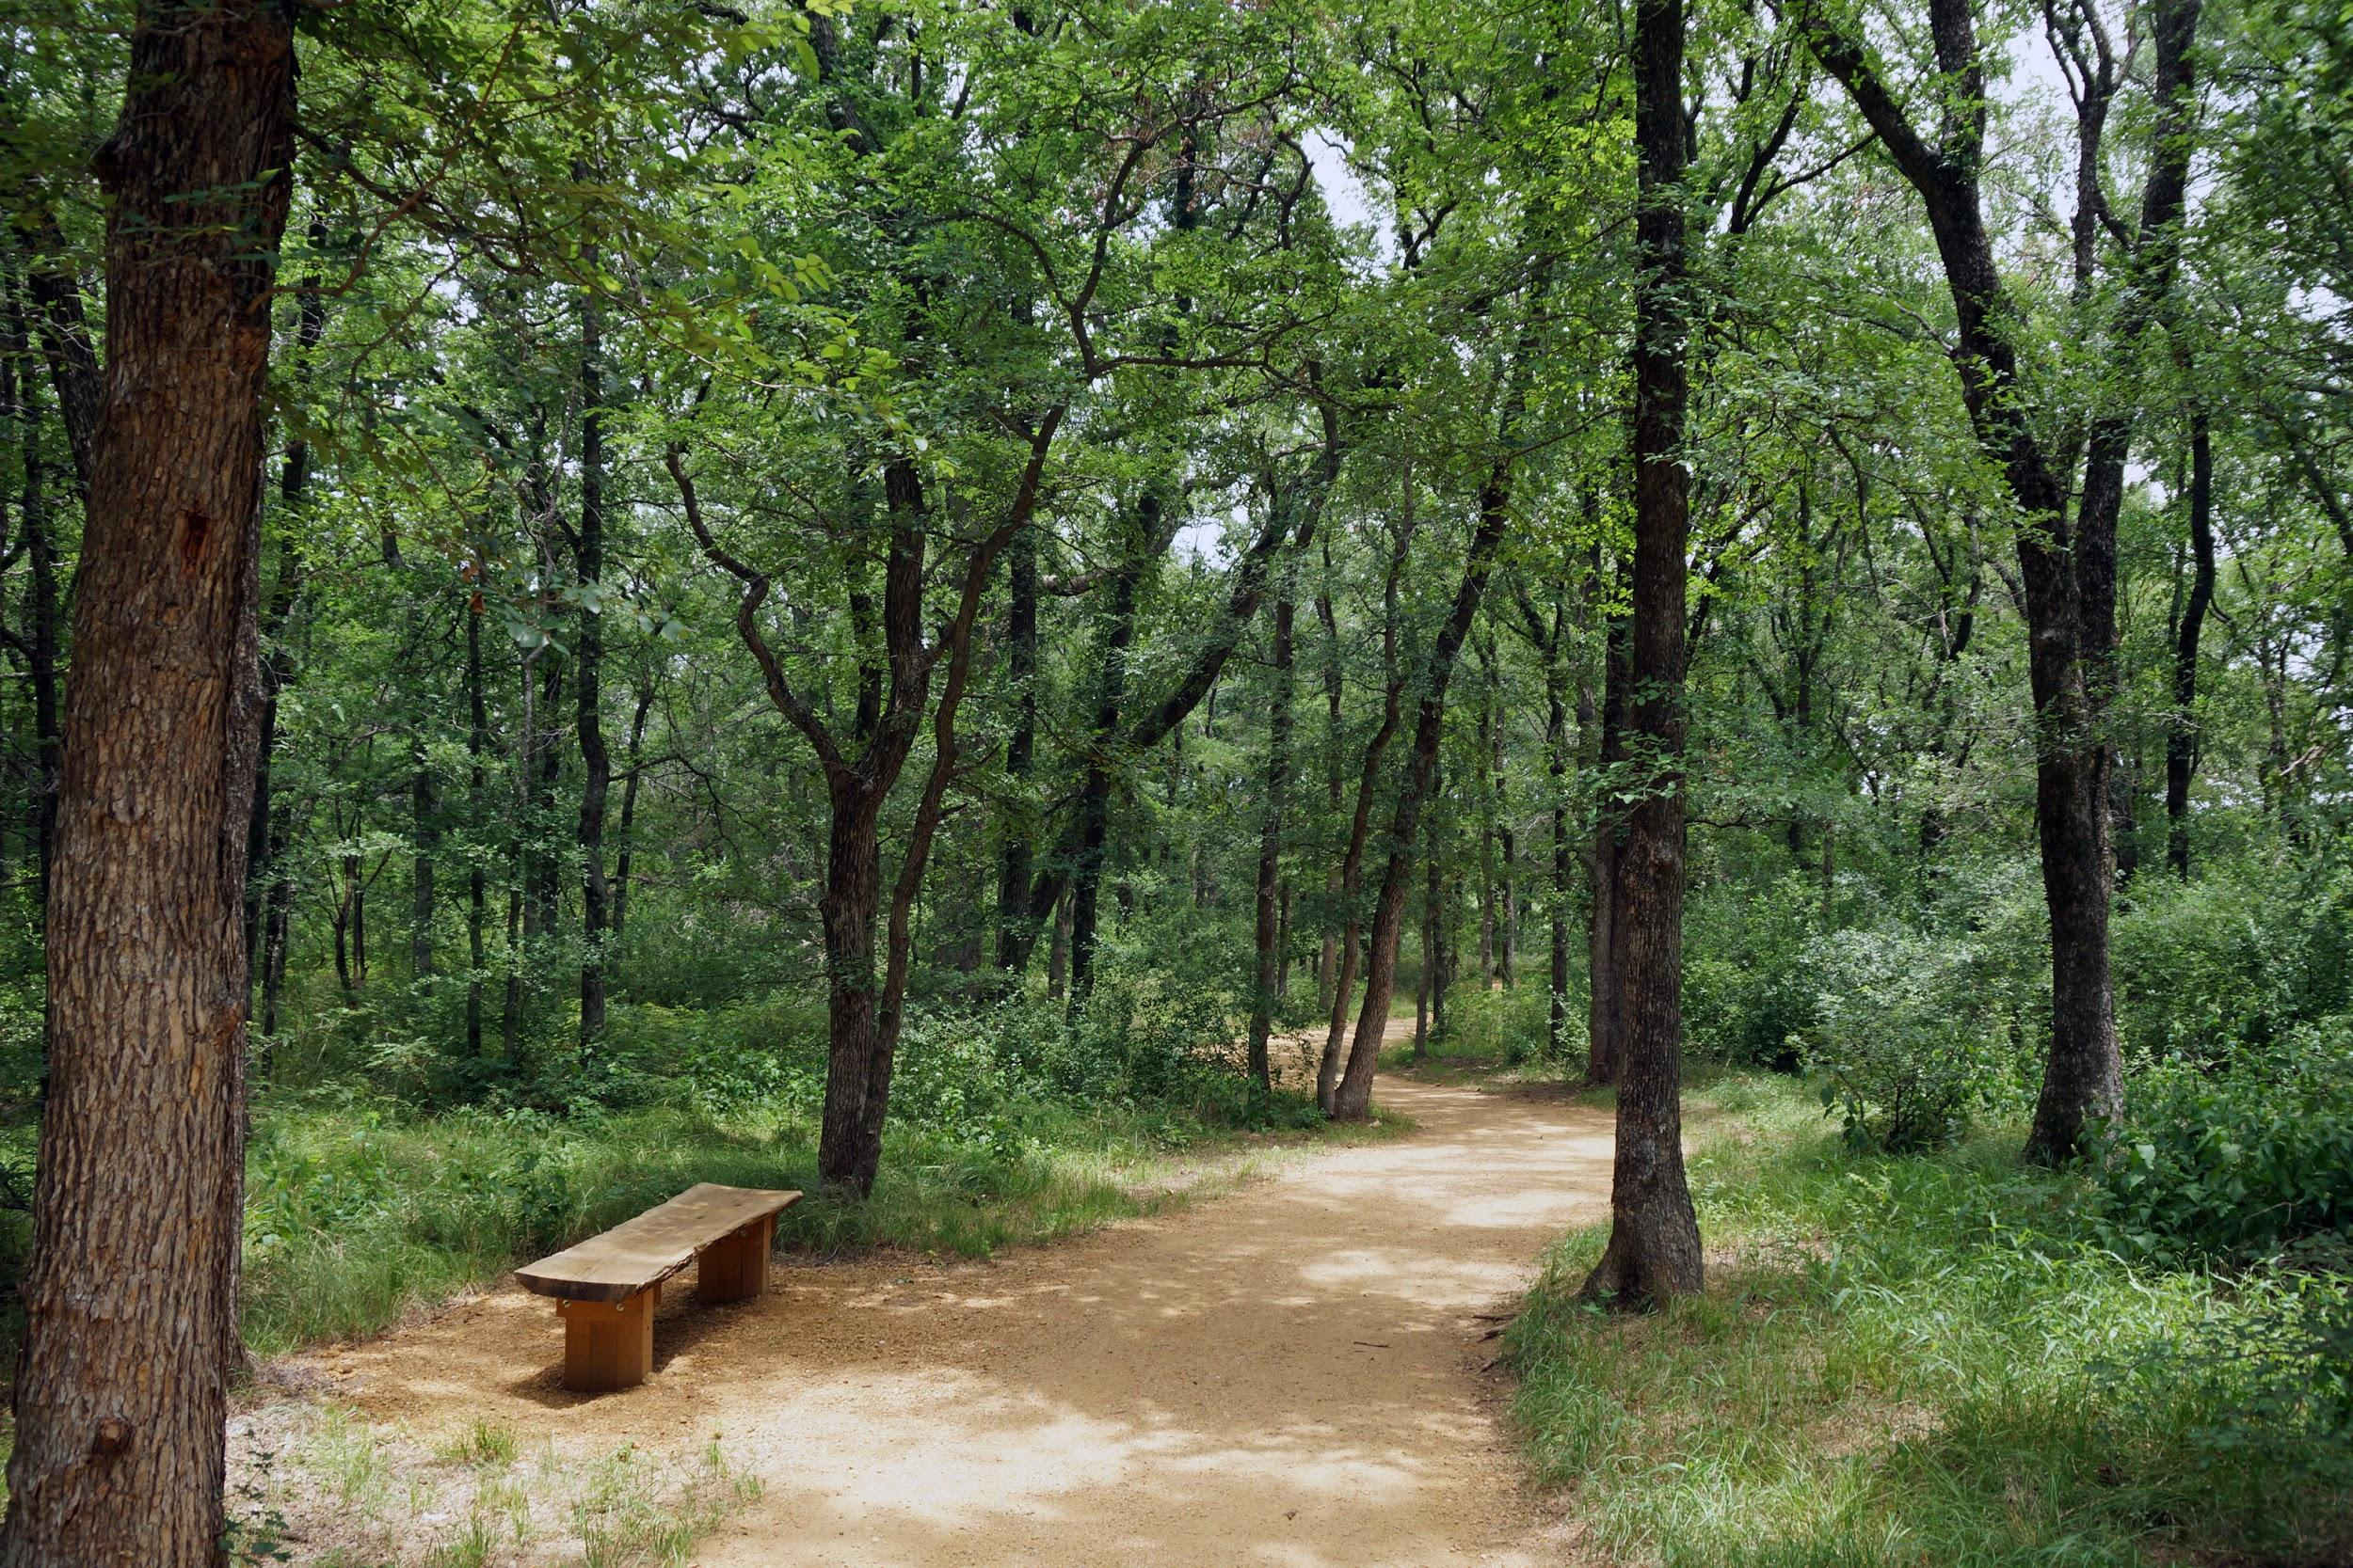
Break

Slide 22
Share out

Slide 23
Transition Strand
tinyurl.com/dlsadapt
Login sbcssadapt
Pin 3819

Slide 24
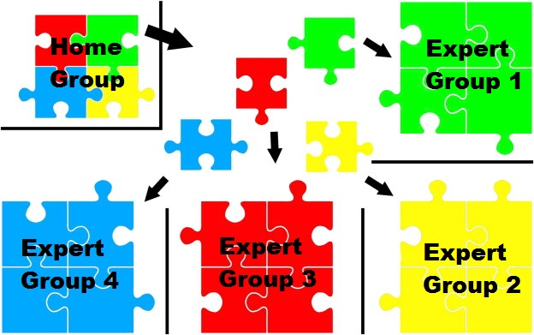
Jigsaw and Share out
Notes:
Jigsaw and Share out

Slide 25
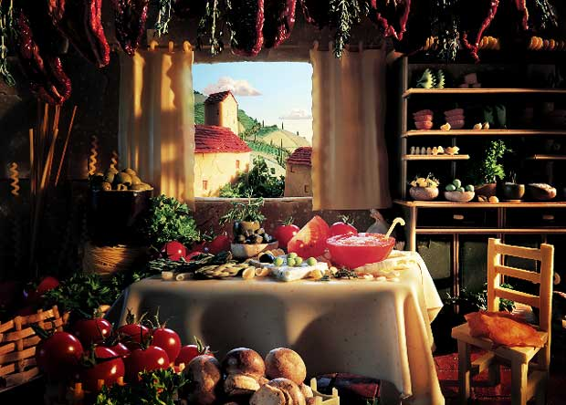
lunch

Slide 26
why an innovative strand?

Slide 27
Rapid Change in Technology

Slide 28
What are the implications for this level of technology?

Slide 29
Again, where do we start?

Slide 30
Notes:
The challenge: Changing the perception of what others see vs what I see or know to be true

Slide 31
Notes:
Start with the computer in your pocket! Share what apps you use at your table and why they have made your life easier.

Slide 32
So what are these tools?

Slide 33
Everyday use
Wunderlist
WhatsApp
Kindle
Audible

Slide 34
Group collaboration
Twitter - Global Connectivity
Tweet Deck - Professional Development
Symbaloo - Bookmarking tool
Doodle - Scheduler
Notes:
For more ideas Web 2.0 Productivity Tools Article

Slide 35
Web 2.0 Tools for student use
Voki
Google CS First
Nearpod
Little Bird Tales
Padlet

Slide 36
Building your innovative strand
Notes:
I start with a smartphone module - perception first, then explain tools

Slide 37
how do you app?
Notes:
Start with the computer in your pocket! Share what apps you use at your table and why they have made your life easier.

Slide 38
ymasumac9@gmail.com
Notes:
Build smartphone presentation

Slide 39
Considering today’s presentation…
pollev.com/ymasumac
Notes:
The Technology Acceptance Model (Hubona & Geitz, 1999)

Slide 40
Reality
Notes:
http://youtu.be/gHGDN9-oFJE

Slide 41
Thank you!
Digital Learning
Project Specialists
ymaranon@sbcss.k12.ca.us
sue_christensen@sbcss.k12.ca.us

